Slide 1
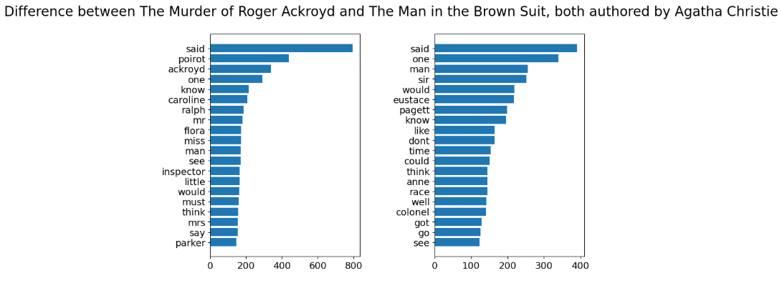
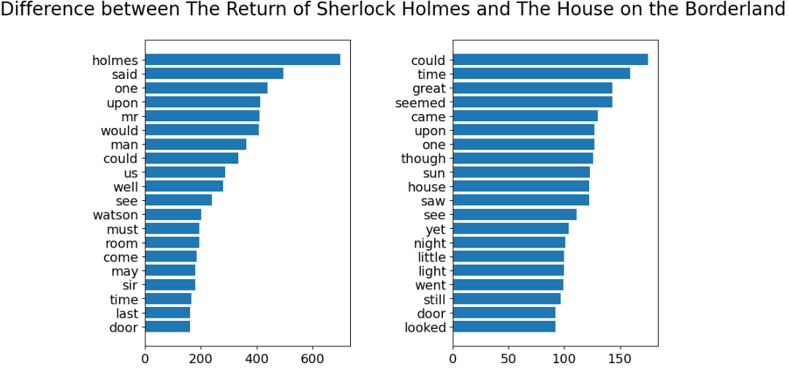
MiniProject1
Word Frequency
Comparison
Looking at repeated word patterns within one author and across different authors.
Gavin Good

Slide 2
RESEARCH QUESTION
What is the question?
Can simple word-frequency charts show meaningful differences in style, topic, and narration?
Same-author comparison
Different-author comparison
Main expectation
The Murder of Roger Ackroyd and The Man in the Brown Suit test whether Agatha Christie repeats similar high-frequency patterns across novels.
The Return of Sherlock Holmes by Arthur Conan Doyle and The House on the Borderland by William Hope Hodgson
test whether word counts shift more when author, genre, and narration style change.
Names and dialogue words should reveal point of view and plot focus, while descriptive words should hint at genre and setting.

Slide 3
METHOD
What was the approach?
Choose texts
Clean text
1
2
Four public-domain texts: one same-author pair and one different-author pair.
Remove HTML, boilerplate, punctuation, numbers, and common stop words.
Count words
Plot charts
3
4
Use a frequency counter to find the most repeated non-stopwords.
Show the top words in side-by-side horizontal bar charts.

Slide 4
DEBUGGING
What problems did I encounter?
The first word lists included punctuation, curly quotation marks, and blank tokens as if they were real words.
Regex strings created warning messages that made the notebook output messy.
Some chart settings caused tick-label issues or made the output harder to read.
Fixes made
Cleaned tokenizer
Normalized apostrophes
Removed stop words after cleaning

Slide 5
RESULTS: SAME AUTHOR
What results did I get?
Agatha Christie comparison
Both novels are dialogue-heavy, with “said” as the strongest repeated word.
Character names dominate the top words, which fits mystery fiction built around people, clues, and conversations.
The different name patterns show that each book centers a different cast and narrator focus.
Takeaway: same author does not mean identical vocabulary, but the shared mystery/dialogue structure still shows up clearly.

Slide 6
RESULTS: DIFFERENT AUTHORS
What changed across different authors?
Doyle vs. Hodgson
The Sherlock Holmes text is shaped by recurring names: “holmes,” “watson,” and “sir.”
The House on the Borderland has more atmosphere-based words like “time,” “seemed,” “sun,” “night,” and “light.”
Genre seems to matter: detective fiction points to characters, while weird fiction points to setting and perception.
Takeaway: the different-author pair produced a stronger style/genre split than the Christie-only pair.

Slide 7
NEXT STEPS
What new ideas did this generate?
Better comparison metric
Look beyond top words
Improve interpretation
Use proportions or ratios instead of raw counts so longer texts do not overpower shorter ones.
Compare unique vocabulary, sentence length, character-name frequency, or chapter-by-chapter changes.
Pair the charts with close reading to explain why specific words appear so often.
Final claim
Word-frequency charts are a useful first pass: they quickly show what each text repeatedly talks about, but the best analysis comes from connecting the numbers back to plot, genre, and narration.

